Slide 1

Study Unit 3
Department of Computer Science
Subject Code: COS1501
Theoretical Computer Science
Primary Lecturer:
Mr. Thapelo Sindane
Dr. Petra Le Roux

Slide 2
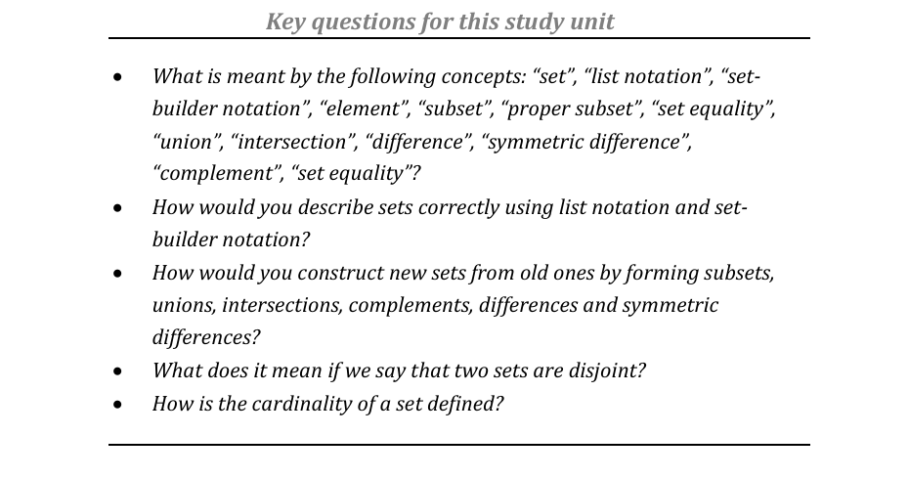
Study unit 3: Sets

Slide 3
Set Theory Definition
Set theory is the mathematical theory of well-determined collections, called sets, of objects that are called members, or elements, of the set.

Slide 4
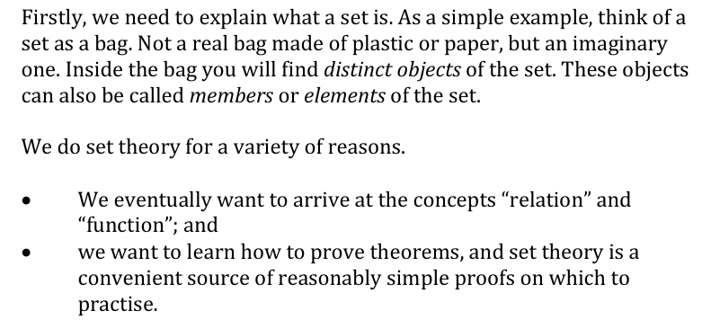
Why do set theory?

Slide 5
Set Formalism
Suppose we want to tell you something about a set of all positive integers less than 5.
We can describe this set as mentioned.
Alternatively we can use list notation, where we identify a set as curly brackets {} all elements of the inserted in the curly braces seperated by commas.
Int_less_5 = {1,2,3,4} what is the problem here?

Slide 6
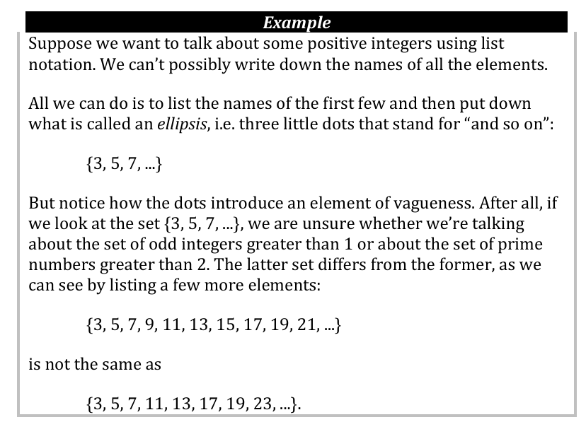
Example

Slide 7
Set Naming and Referencing
The third method involves giving sets names:
E.g. Lets A be a set of all positive intergers less than 5.
Whenever we want to talk about this set, we only refer to it as A.

Slide 8
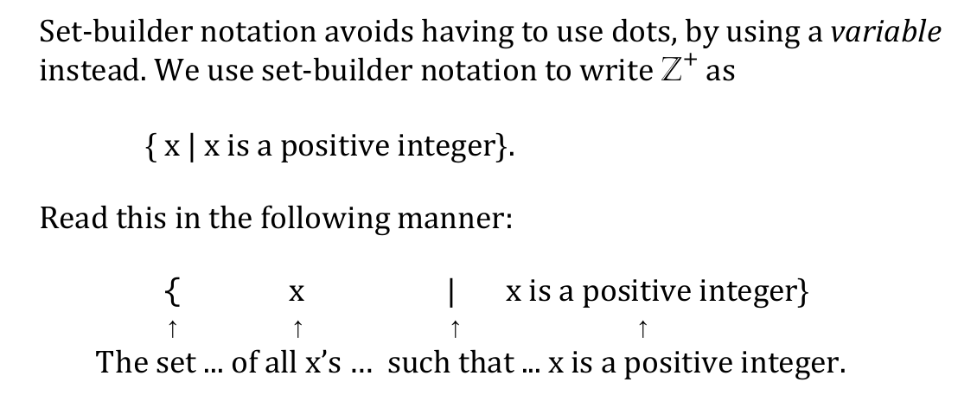
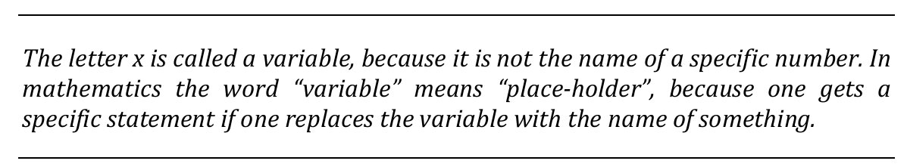
Set builder notation

Slide 9
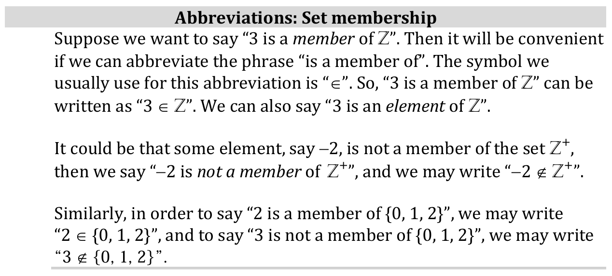
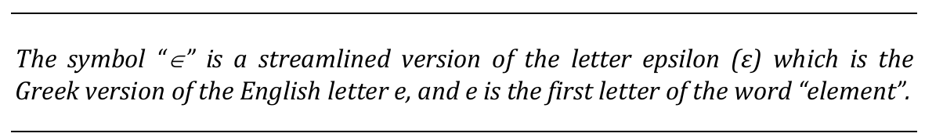
Tools for builder notations

Slide 10
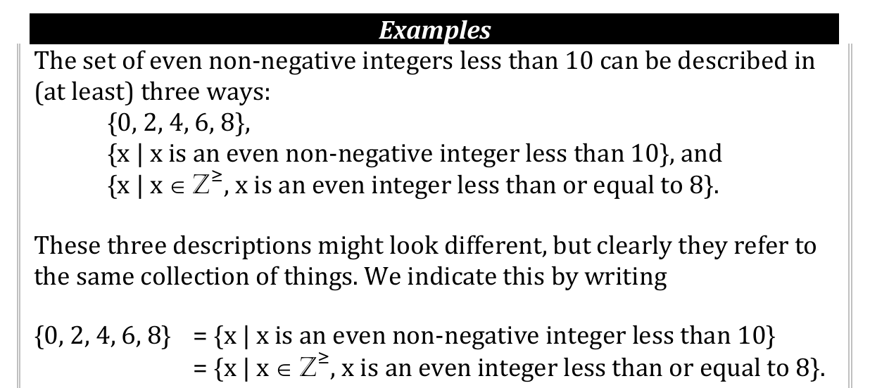
Examples

Slide 11
Practice examples
Using List notation and Builder notation Show how you would to talk about the set of all negative integers greater than −5.

Slide 12
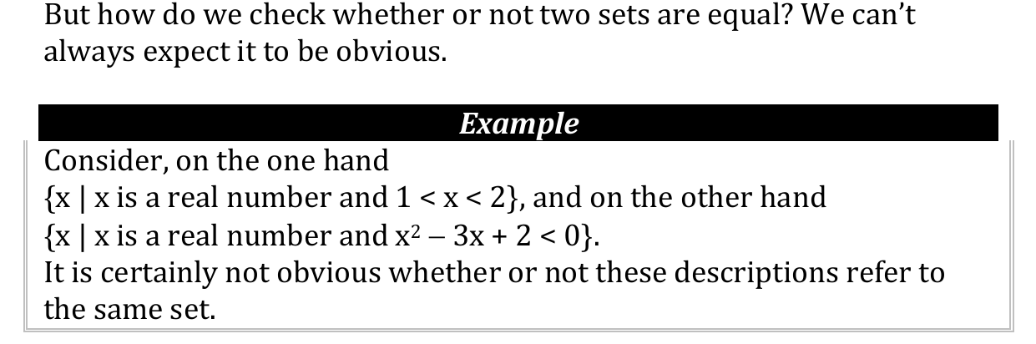
Check set equality

Slide 13
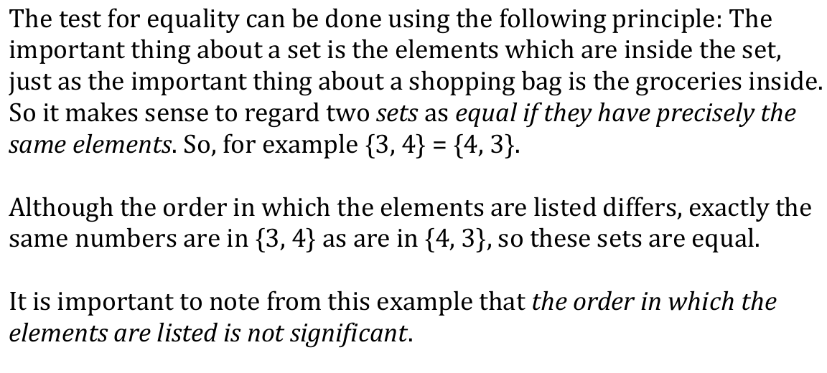
Shopping items analogy: presence over order

Slide 14
Practice example
Let A = {2,3} and B= {3,2,3} are the two sets equal. That can we say {2,3} = {3,2,3} ?

Slide 15
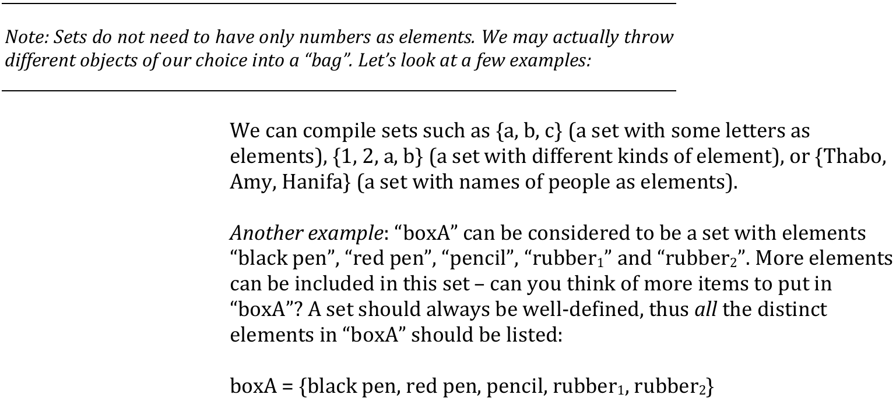
What can be an element of a set ?

Slide 16
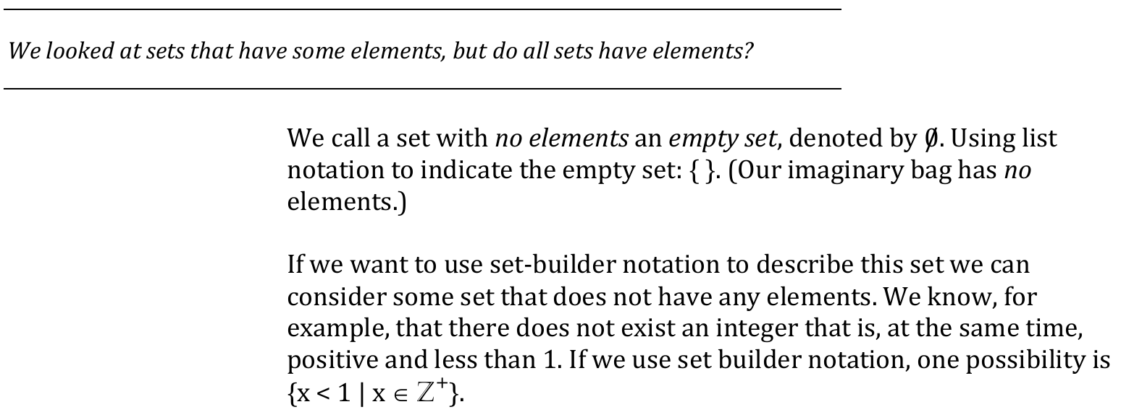
The empty set

Slide 17
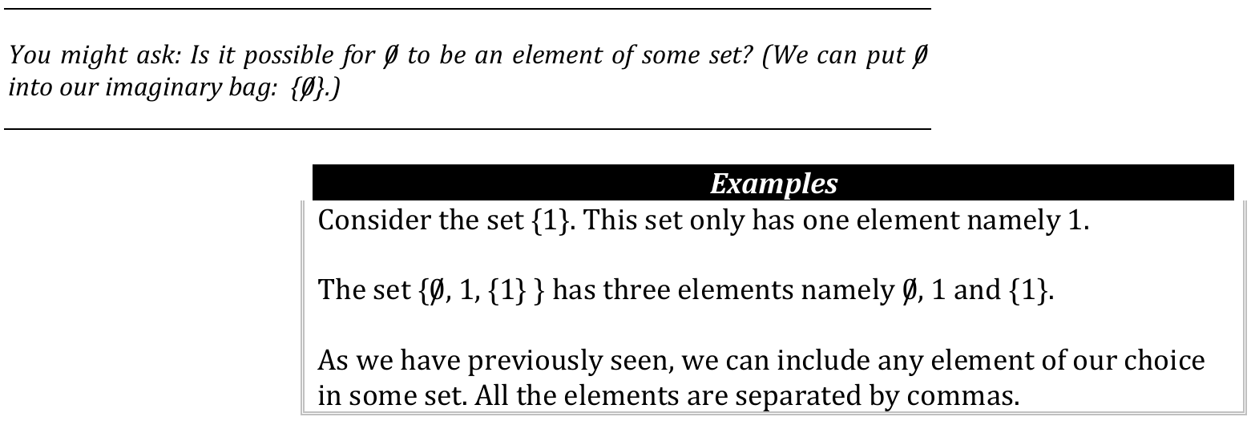
Can an empty set be an element of a set?

Slide 18
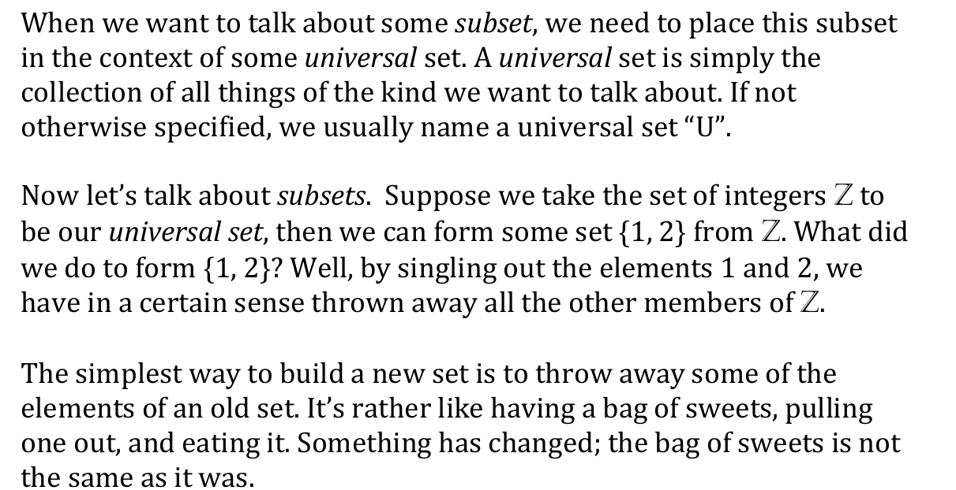
Subset

Slide 19
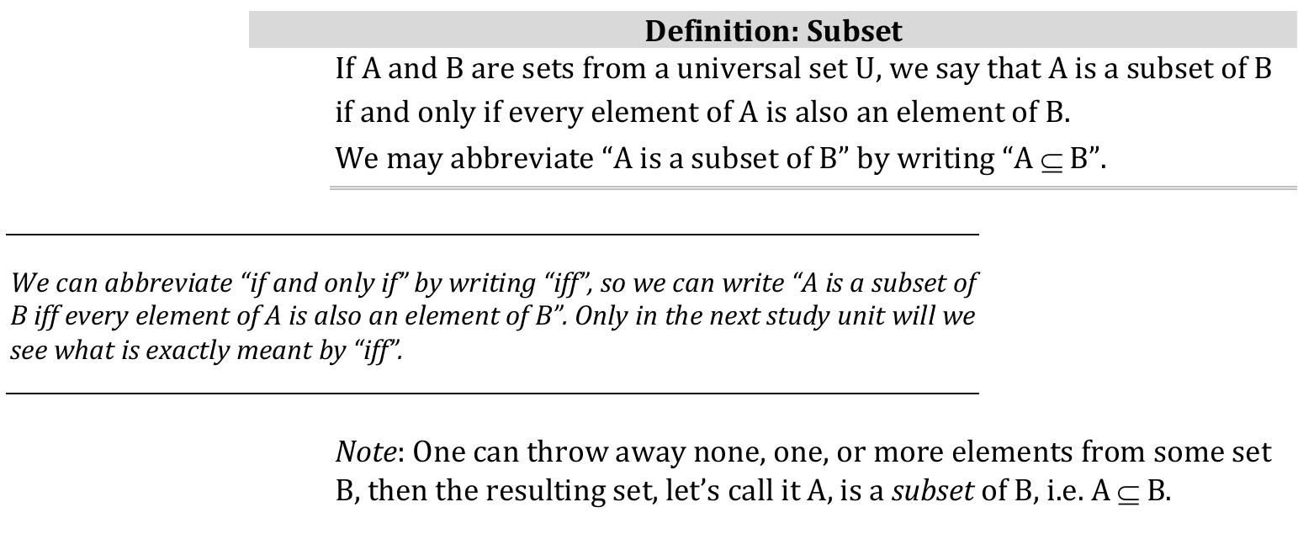
Subset Definition

Slide 20
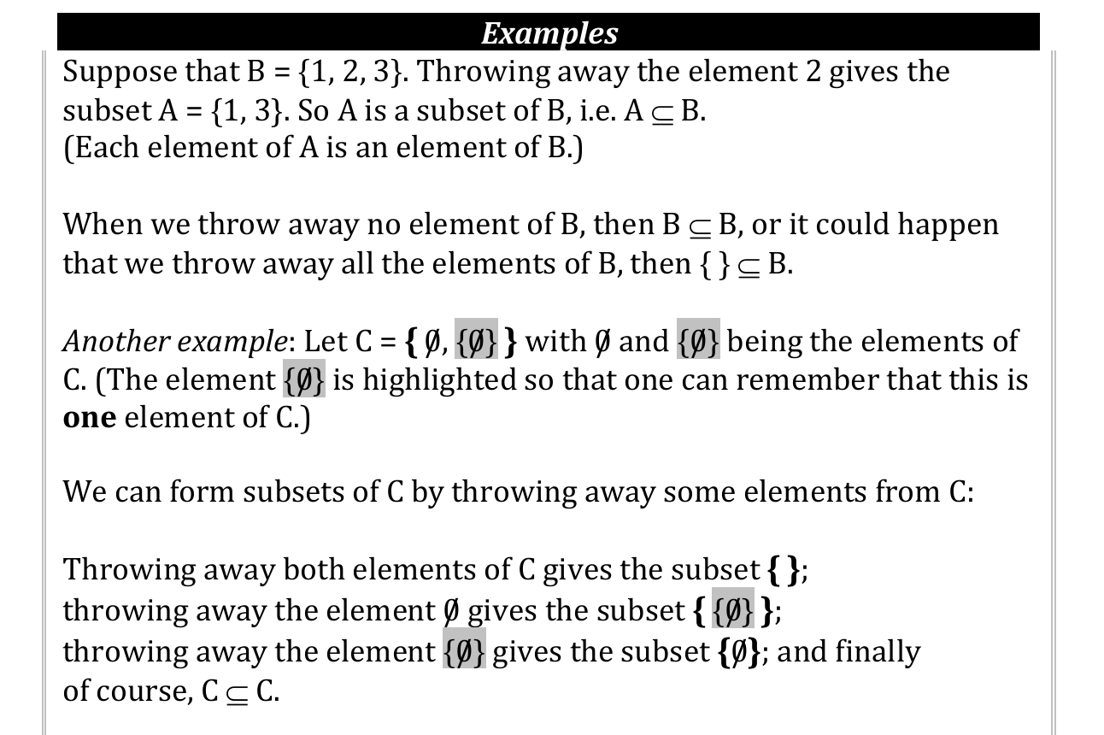
Subset Examples

Slide 21
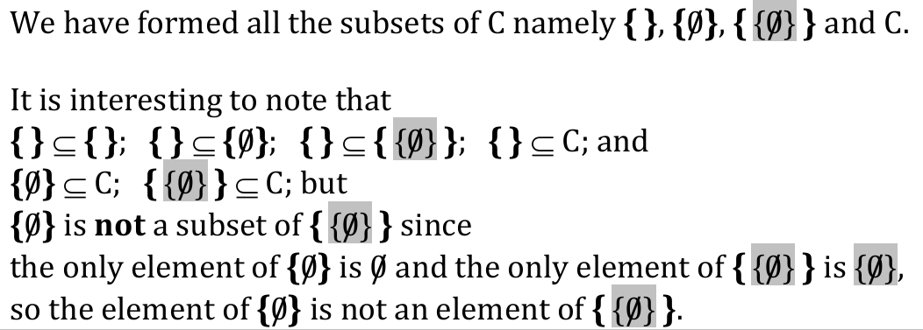
Subset Examples

Slide 22
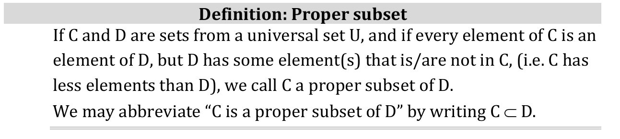
Proper Subsets

Slide 23
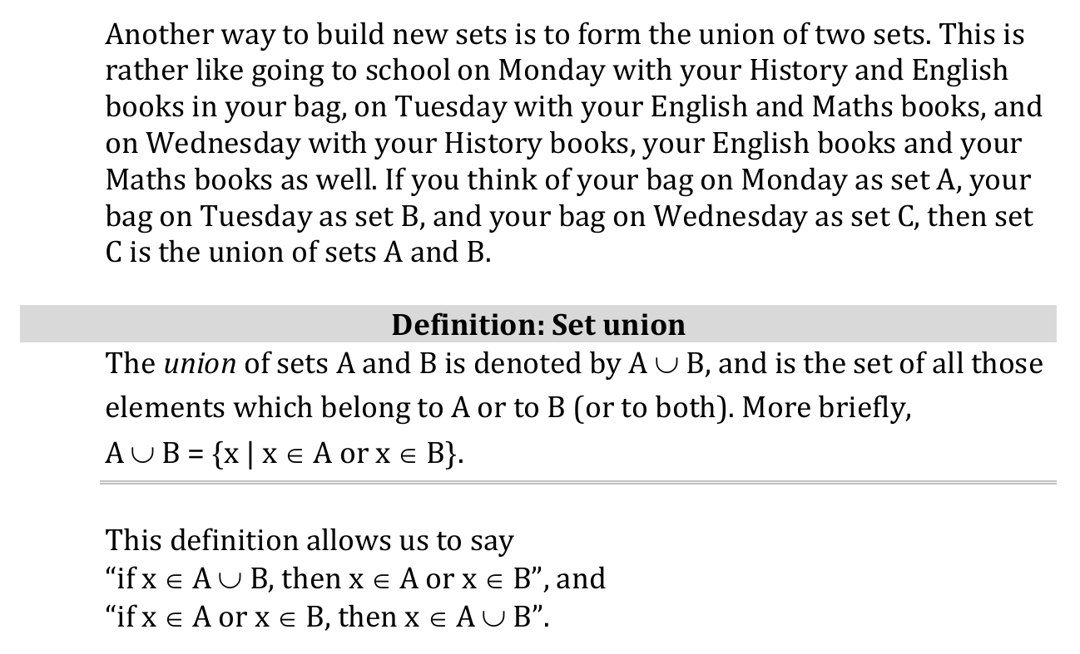
Union of a Set

Slide 24
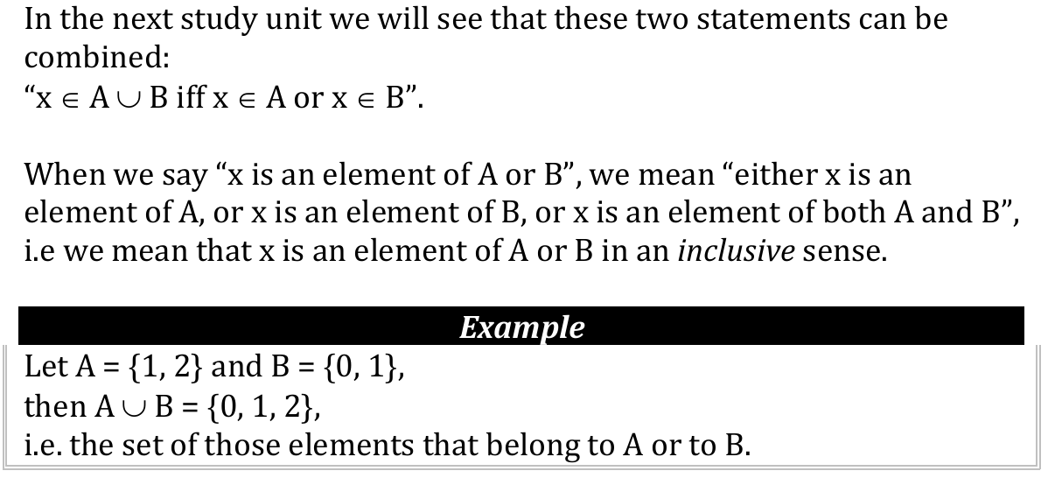
Union example

Slide 25
Union Practice
Let A= {a,2,3,d}, and B={1,c,b, 2,4}, find the Union of A and B.

Slide 26
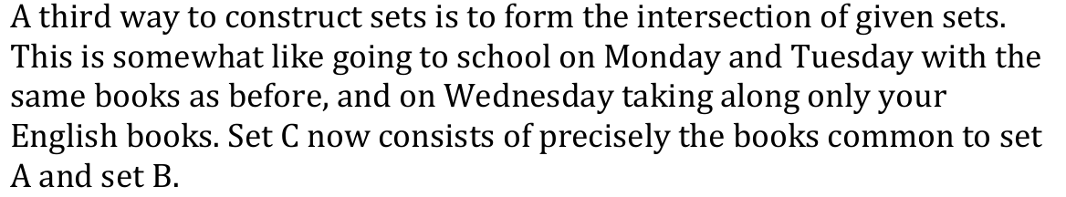
The Intersection

Slide 27
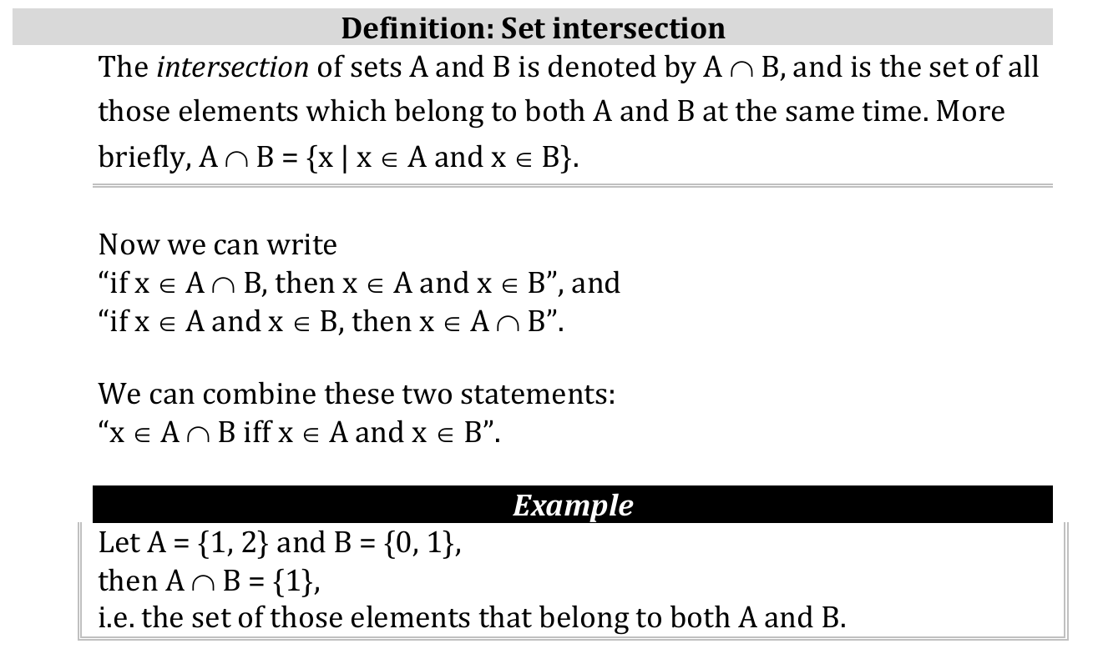
Intersection Definition

Slide 28
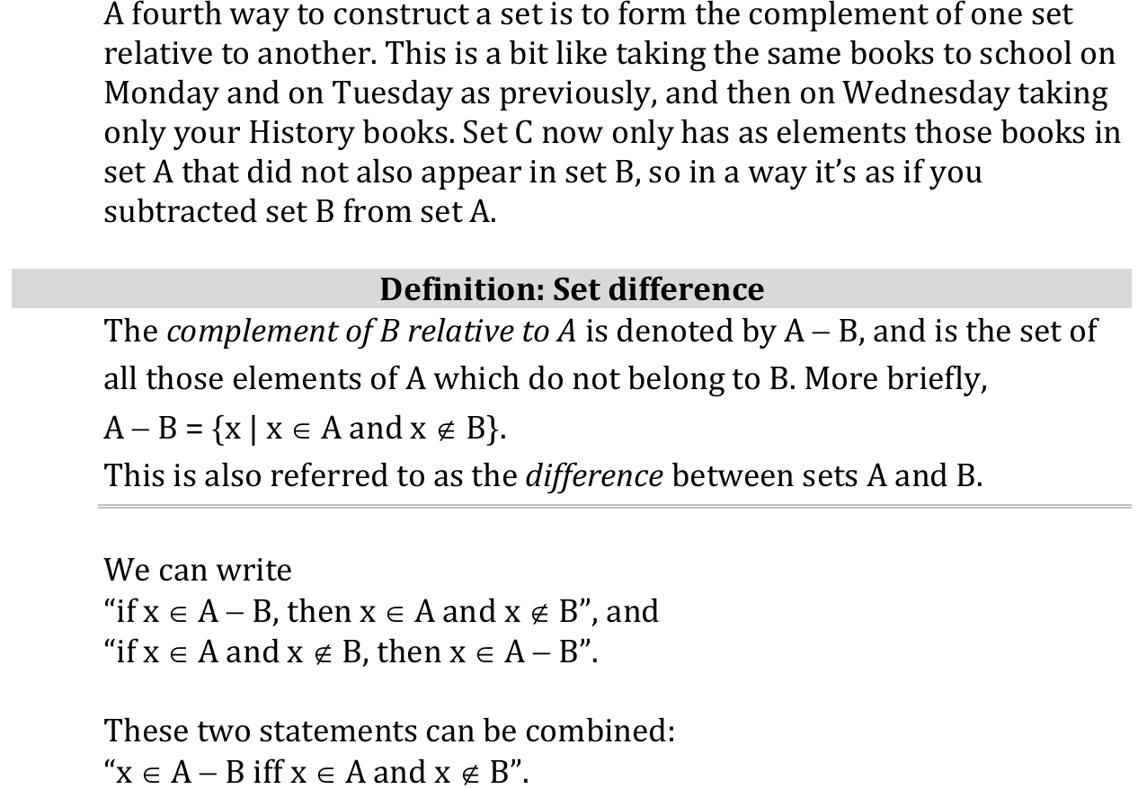
Set Complement

Slide 29
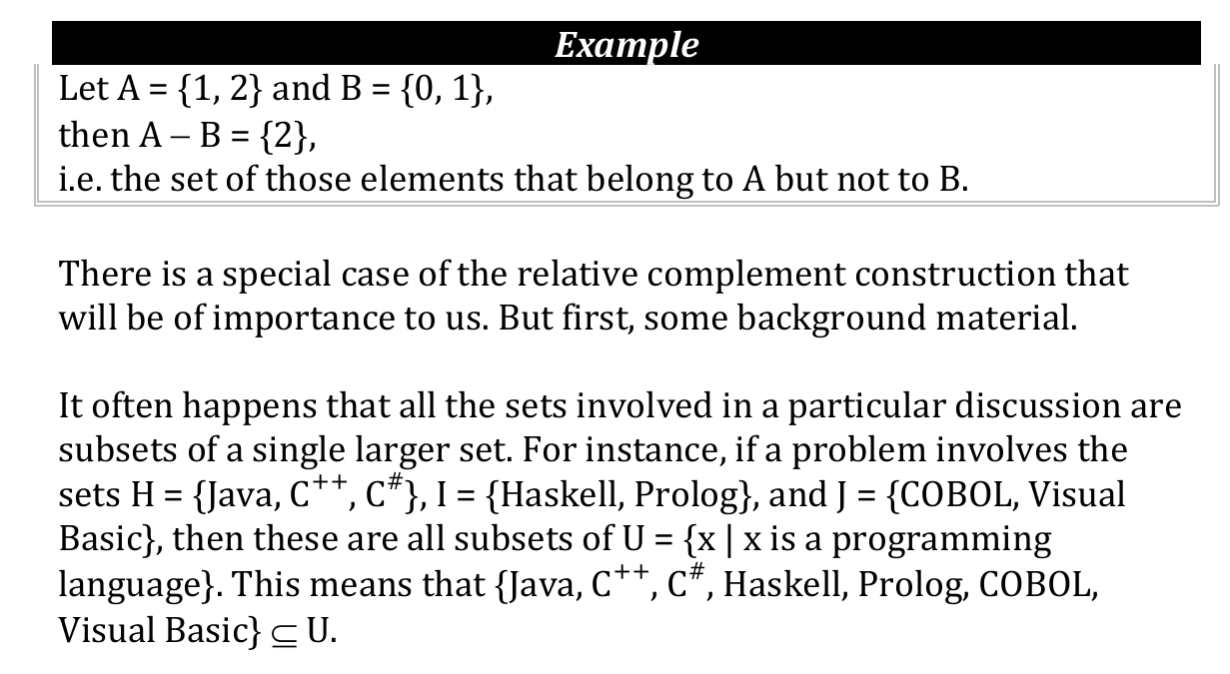
Set Complement Example

Slide 30
Set Complement Practice
Let A = {1,p,q} and B ={1, {}, q, a, p}, find complement of A relative to B and complement of B relative to A.

Slide 31
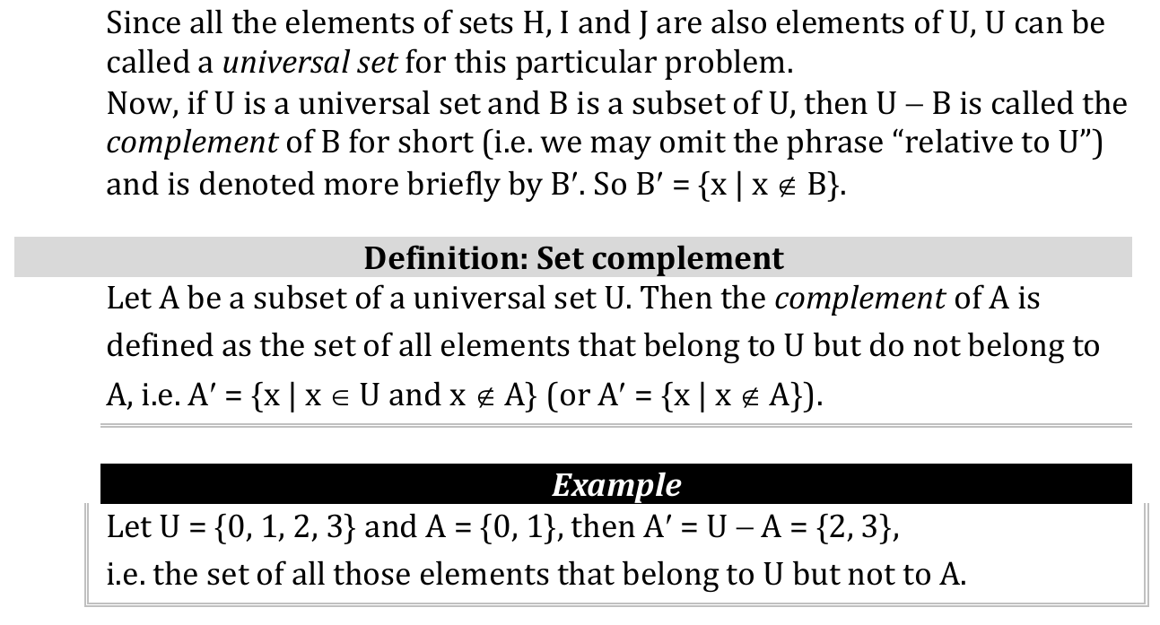
Set Complement

Slide 32
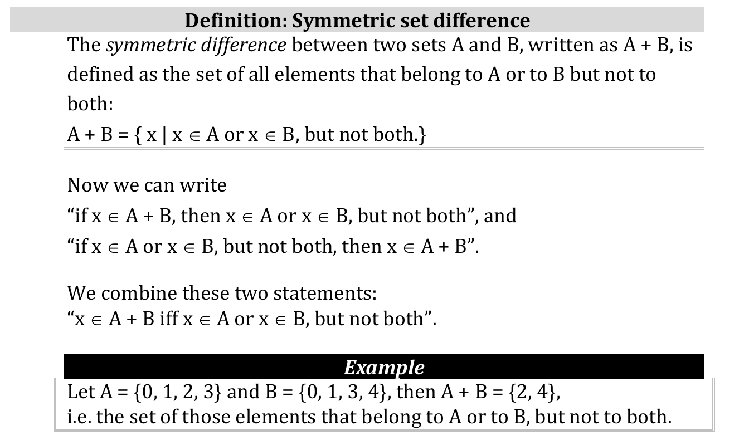
Symmetry

Slide 33
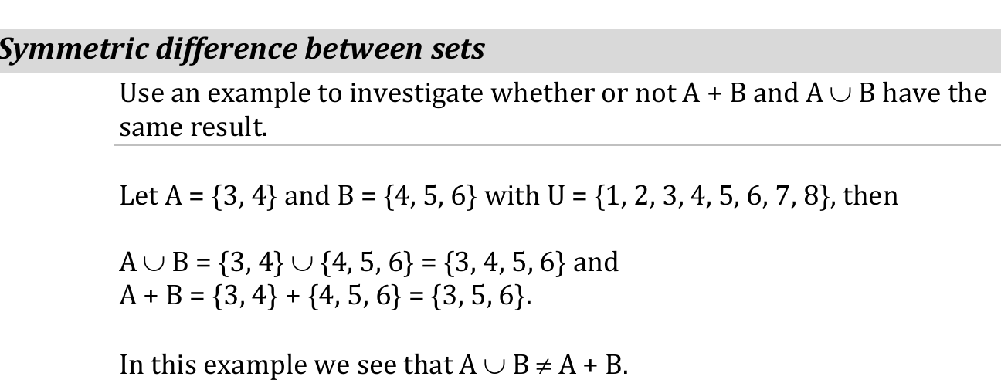
Symmetrical difference between sets

Slide 34
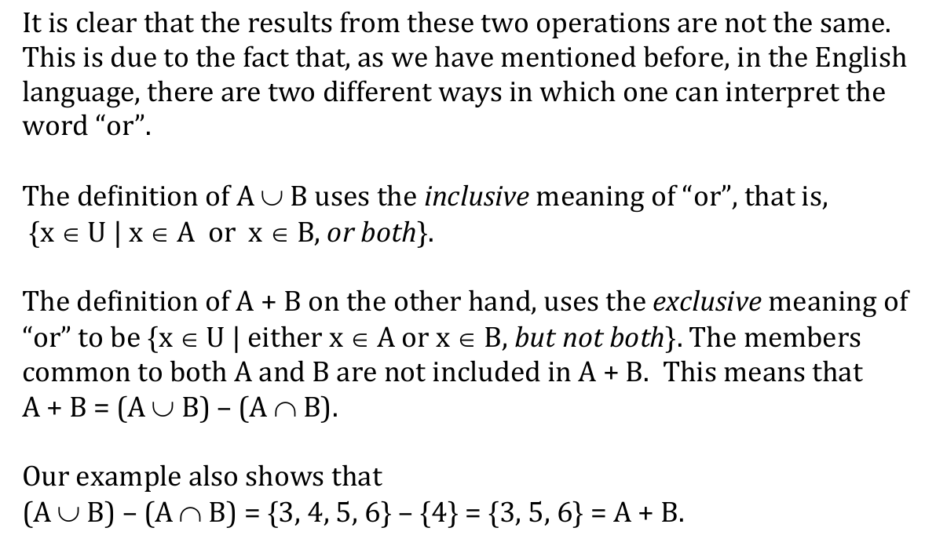
Symmetry: Union complement intersection

Slide 35
Teaser
When would it be possible for the symmetry of set A and B be equal to their Union?

Slide 36
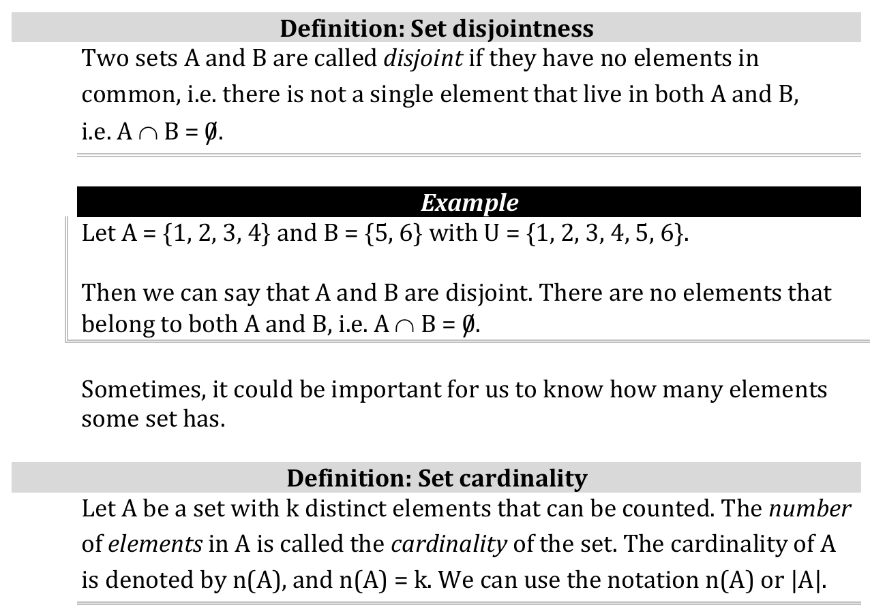
Set disjointness and cardinality

Slide 37
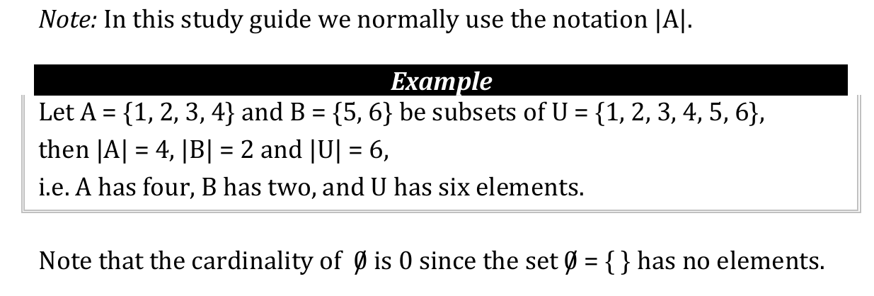
Cardinality example

Slide 38
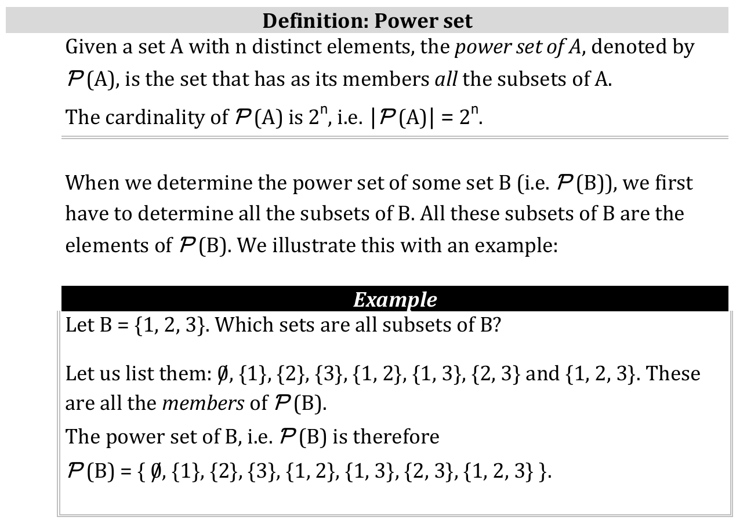
Power sets

Slide 39
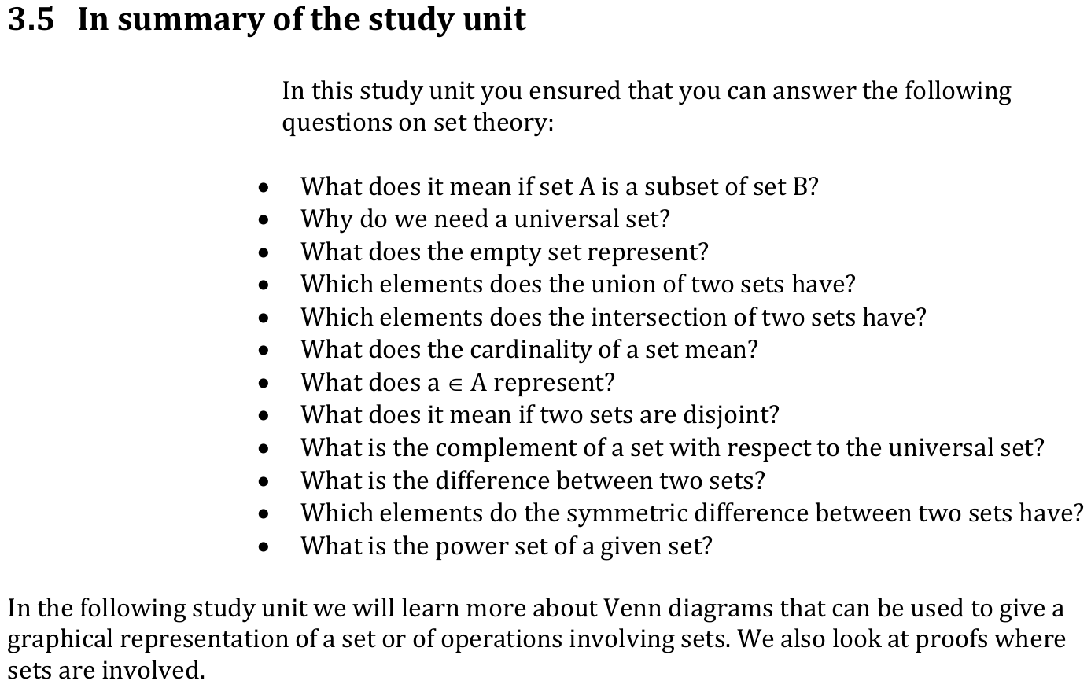
Summary

Slide 40
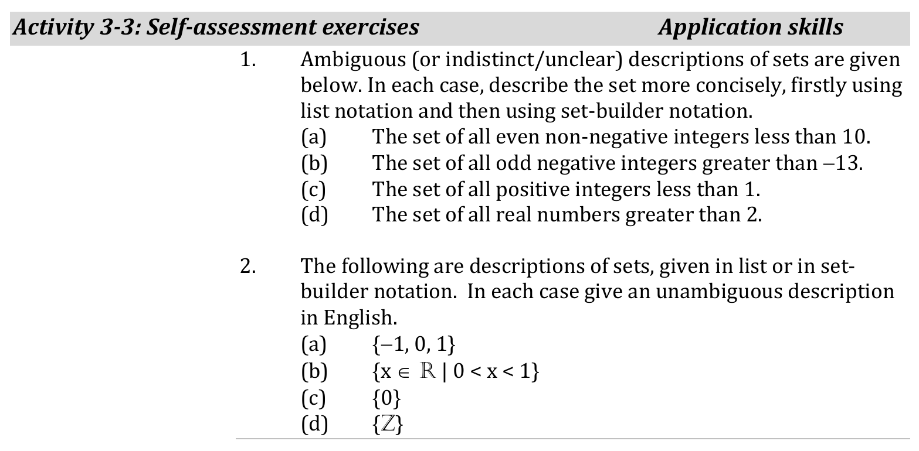
Assessments

Slide 41
Assessments
Do Activity 3-6: Self-assessment exercises

